Slide 1
Rockbuster Stealth
Online Platform Launch Strategy

Slide 2
Presentation Overview
01
02
03
ABOUT US
The present state and future fate of Rockbuster Stealth.
MARKET ANALYSIS
Overview and analysis of current movie and customer trends.
GOALS & STRATEGY
Recommendations for successful conversion to an online business platform.

Slide 3
Rockbuster Stealth:
A retail movie rental company, faces stiff competition from online streaming services such as Hulu, Netflix and Amazon to maintain and grow a customer base. In order to effectively compete, should Rockbuster transition to a similar online streaming service platform?

Slide 4
Customer and store overview
599
2
2
Number of customers
Number of stores
Number of staff
Based on limited customers, number of stores, and staff, transitioning Rockbuster to an online platform would result in greater customer numbers, cut unnecessary property rental costs, and minimally affect current employment.

Slide 5
Film overview
Number of films
offered
Average rental cost
115 minutes
1000
5 days
$2.98
Average rental duration
Average movie length
With an online platform, Rockbuster would be able to revolutionize their business model to offer a competitive amount of movies, introduce TV shows, offer multiple rental costs and durations.

Slide 6
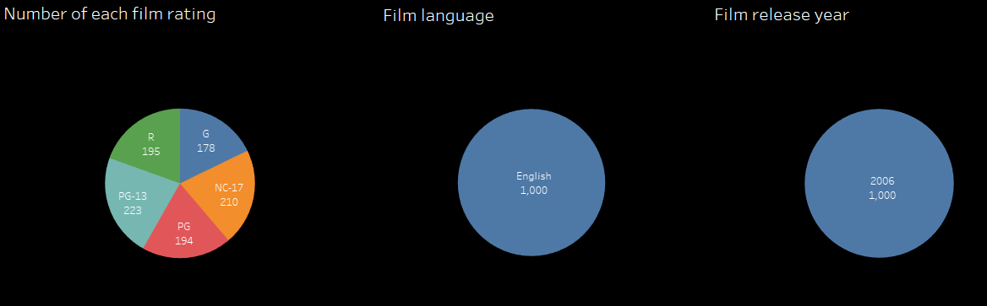
Inventory characteristics
Currently, Rockbuster does not have a wide selection of movie languages and release years. Transitioning the business online would allow Rockbuster to offer a wider selection of titles having a variety of characteristics to attract more customers from around the world.

Slide 7
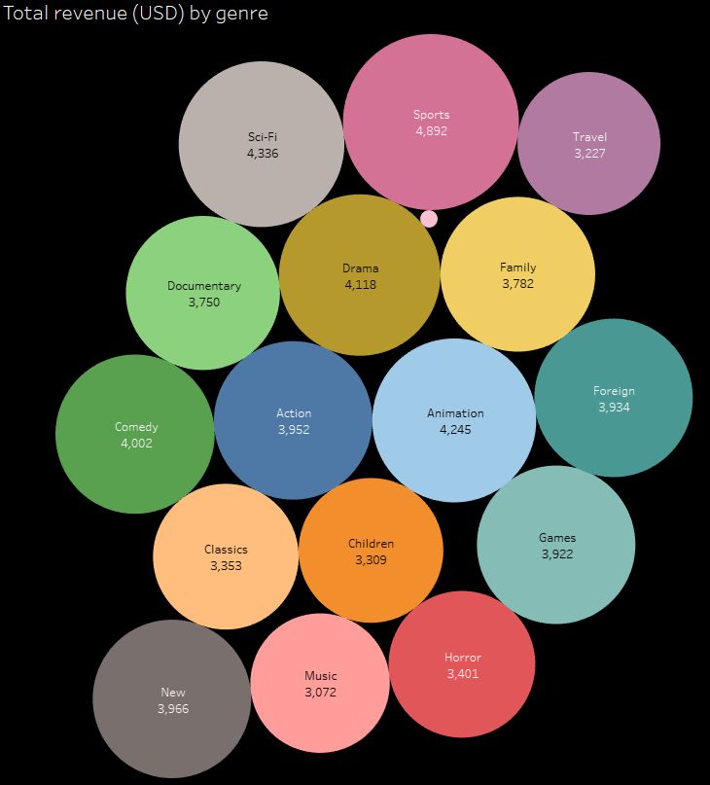
What are customers watching?
Total revenue is shared fairly equally among movie genres, with sports being the most popular category and thrillers the least (very small bubble).

Slide 8
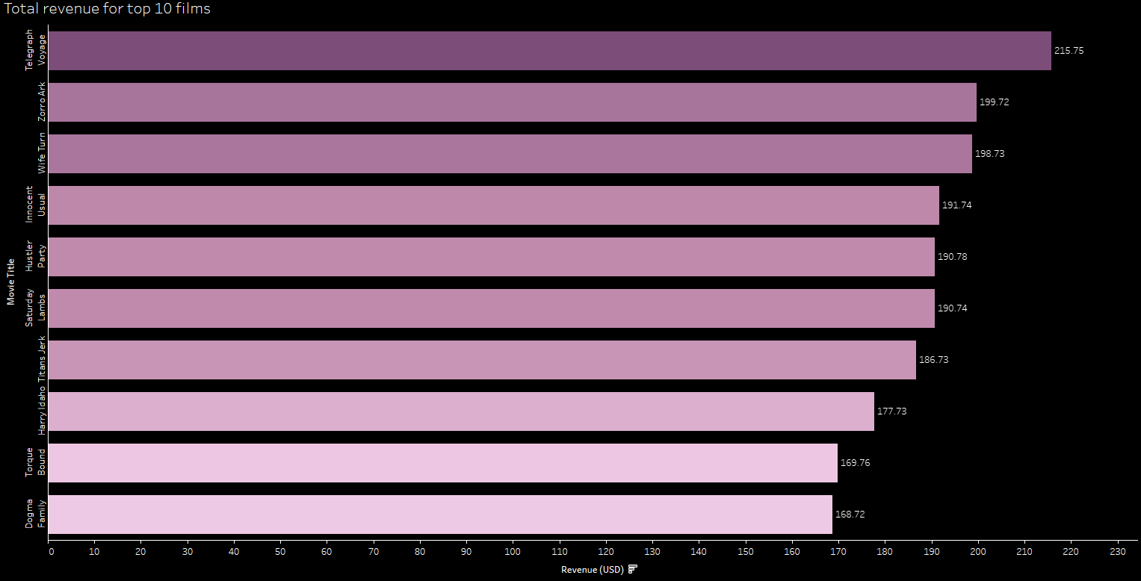
The top 10 films made a combined $1890.40, accounting for about 3% of the total $61,312.04 revenue.

Slide 9
Where are customers located?

Slide 10
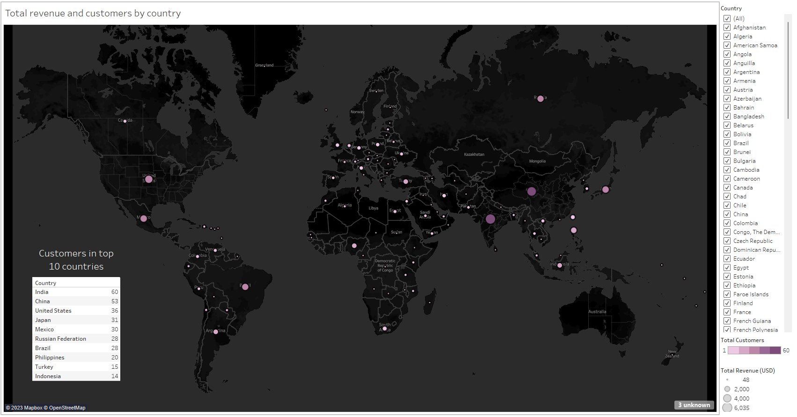
Most customers and total revenue are centralized in Asia and North America.

Slide 11
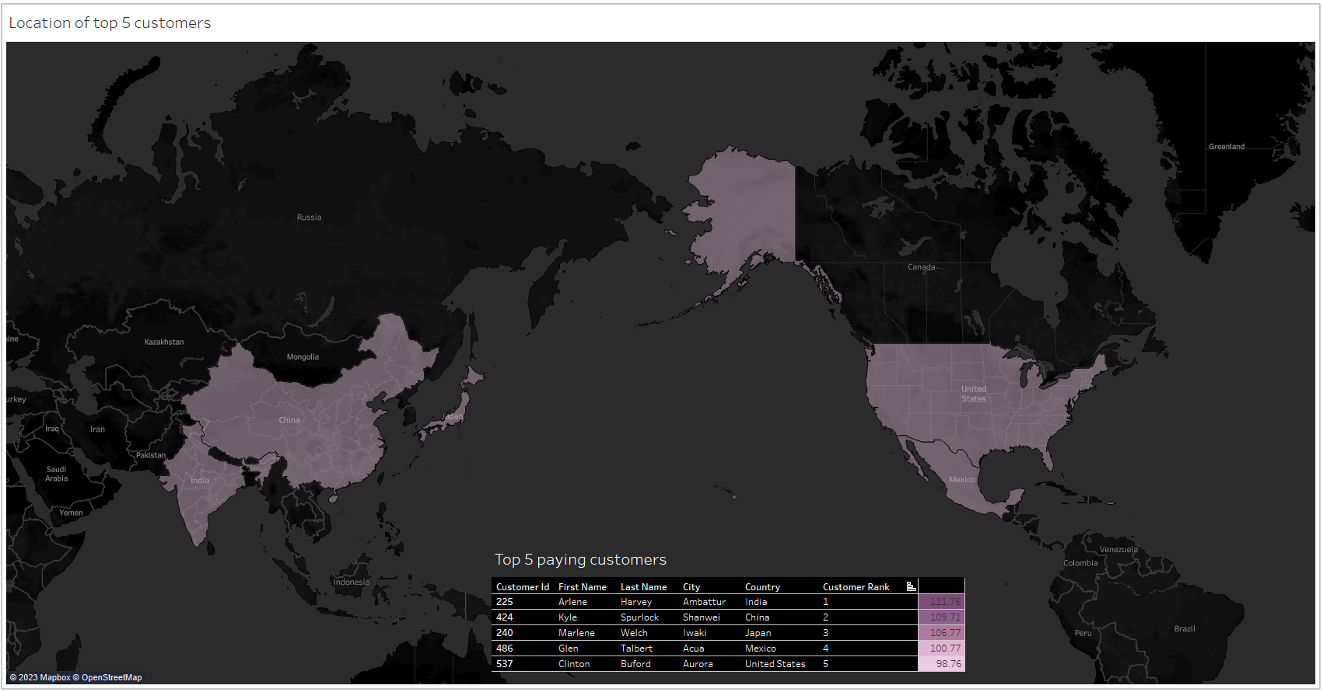
The top paying customers are also located in Asia and North America. Three in Asia and two in North America.

Slide 12

Recommendations for Rockbuster’s future
Make the transition to an online platform
The platform will allow a wider selection of movies and shows to attract more customers.
Targeted marketing
Focus initial marketing in top performing Asia and North America then the rest of the world.
Offer subscriptions and rewards programs
Offer tiers of subscription packages and incentivize more spending with rewards programs, such as monthly free movies.

Slide 13
Thank you for your attention

